Slide 1
Web Services Seminar:
Service Description Languages
Andrei Manuel Dub
Yuan Liu

Slide 2
Service Description Language
From Microsoft
Describing network services(general)
Abstract functionality
Concrete details
Conformance criteria for documents
SDL
Web +
= WSDL
Notes:
Describing the abstract functionality of a service as well as a framework for describing the concrete details of a service description. It also defines the conformance criteria for documents in this language.

Slide 3
What is
UDDI
WSDL stands for
Web Services Description Language
WSDL is written in XML
WSDL is an XML document
WSDL is used to describe Web services
WSDL is also used to locate Web services
WSDL is a W3C recommendation
WSDL
SOAP
Notes:
SOAP defines how the messages is transported, while WSDL is used for define web services.

Slide 4
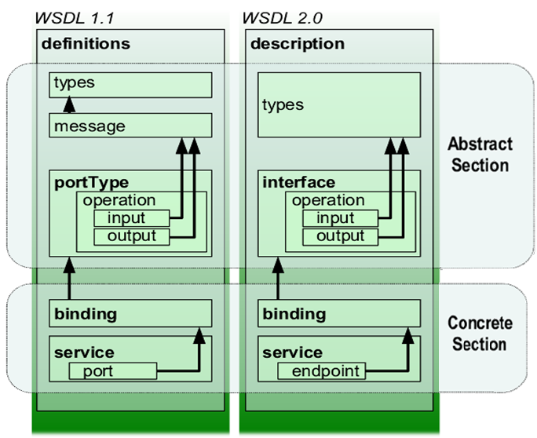
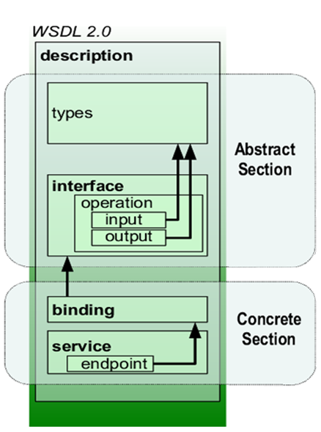
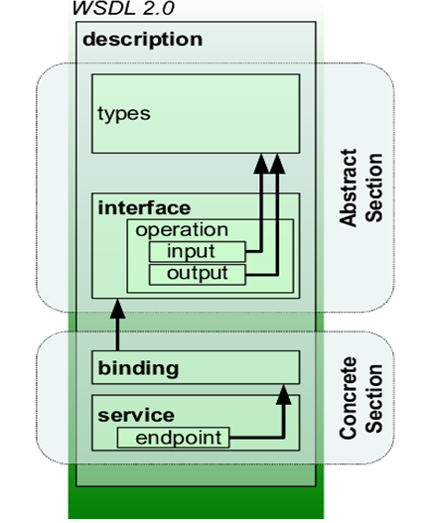
Structure
<description>
<documentation />?
[ <import /> | <include /> ]*
<types />?
[ <interface /> | <binding /> | <service /> ]*
</description>
Src: wikipedia http://en.wikipedia.org/wiki/File:WSDL_11vs20

Slide 5
Src: Web Services Description Language (WSDL) Version 2.0 Part 0: Primer:Figure 2-1. WSDL 2.0 Infoset Diagram

Slide 6
namespace
Namespace in the description label:
Decide on a WSDL 2.0 target namespace URI
and other namespaces
<?xml version="1.0" encoding="utf-8" ?>
<description xmlns="http://www.w3.org/ns/wsdl"
  targetNamespace= "http://greath.example.com/2004/wsdl/resSvc"
  xmlns:tns= "http://greath.example.com/2004/wsdl/resSvc"
  xmlns:ghns = "http://greath.example.com/2004/schemas/resSvc"
  xmlns:whttp="http://www.w3.org/ns/wsdl/http"
. . . >
Notes:
Interface, binding
and service names that we define in our WSDL 2.0 document will be associated with the WSDL 2.0 target
namespace

Slide 7
types
Message types:
A good start point is to describe the types of
messages that our services will use.
<types>
  <xs:schema targetNamespace="http://greath.example.com/2004/schemas/
  resSvcWrapper">
    <xs:import namespace="http://greath.example.com/2004/schemas/resSvc"
    schemaLocation= "http://greath.example.com/2004/schemas/resSvc.xsd"/>
  </xs:schema>
</types>
Not limited in XML Schema

Slide 8
interface
Define the operations to be performed by
Web Services and the messages it used
<wsdl:interface name="BookListInterface">
  <wsdl:operation name="getBookList"
    pattern="http://www.w3.org/ns/wsdl/in-out"
    style="http://www.w3.org/ns/wsdl/style/iri"
    wsdlx:safe="true">
      <wsdl:documentation> This operation returns a list of books.
      </wsdl:documentation>
      <wsdl:input element=""/>
      <wsdl:output element=""/>
  </wsdl:operation>
</wsdl:interface>

Slide 9
binding
It specifies the format of the concrete message and the details of the transmission protocol . (SOAP 1.2 and HTTP)
<wsdl:binding name="BookListHTTPBinding"
  type="http://www.w3.org/ns/wsdl/http"
  interface="tns:BookListInterface">
  <wsdl:operation ref="tns:getBookList" whttp:method="GET"/>
</wsdl:binding>
Each interface construct has a binding counterpart.
Notes:
We still didn’t define how those messages can be exchanged.
But binding is not binded to only one interface

Slide 10
service
Where the service can be accessed.
<wsdl:service name="BookList" interface="tns:BookListInterface">
<wsdl:endpoint name="BookListHTTPEndpoint"
binding="tns:BookListHTTPBinding"
address="http://www.bookstore.com/books/">
</wsdl:endpoint>
</wsdl:service>
Note that one service is to one interface!

Slide 11
More On WSDL
If you are interested in…
import/include mechanisms
namespaces
Mapping to RDF and Semantic Web
extensibility

Slide 12
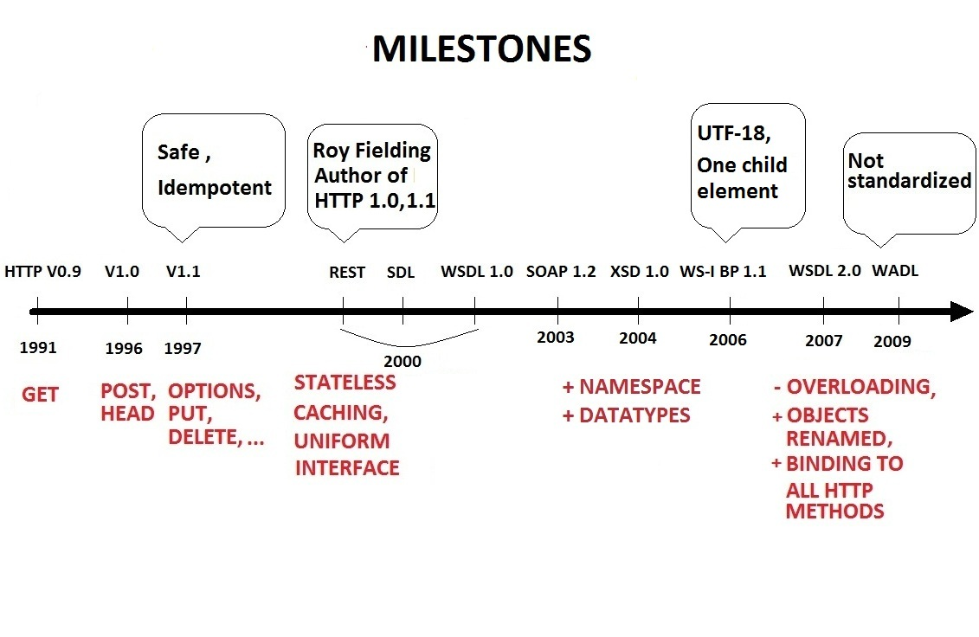
An overview

Slide 13
SOAP Encoding
How can we define the mapping?
WSDL
WSDL describes Services
SOAP transports messages
SOAP
Notes:
When you create a WSDL binding that maps a portType's operations to SOAP messages sent over HTTP, you have to specify whether the SOAP messages contain literal or encoded instances of the schema constructs the operations use. If you choose "literal," you are saying that the XML Schema constructs your WSDL definitions refer to are concrete specifications of what will appear in your SOAP message bodies. If you choose "encoded," you are saying that the XML Schema constructs your WSDL definitions refer to are abstract specifications of what will appear in your SOAP message bodies; these can be made concrete by applying the rules defined by SOAP encoding.

Slide 14
SOAP Encoding
Literal
Concrete
WSDL
SOAP
Notes:
When you create a WSDL binding that maps a interface’s operations to SOAP messages sent over HTTP, you have to specify whether the SOAP messages contain literal or encoded instances of the schema constructs the operations use. If you choose "literal," you are saying that the XML Schema constructs your WSDL definitions refer to are concrete specifications of what will appear in your SOAP message bodies. If you choose "encoded," you are saying that the XML Schema constructs your WSDL definitions refer to are abstract specifications of what will appear in your SOAP message bodies; these can be made concrete by applying the rules defined by SOAP encoding.

Slide 15
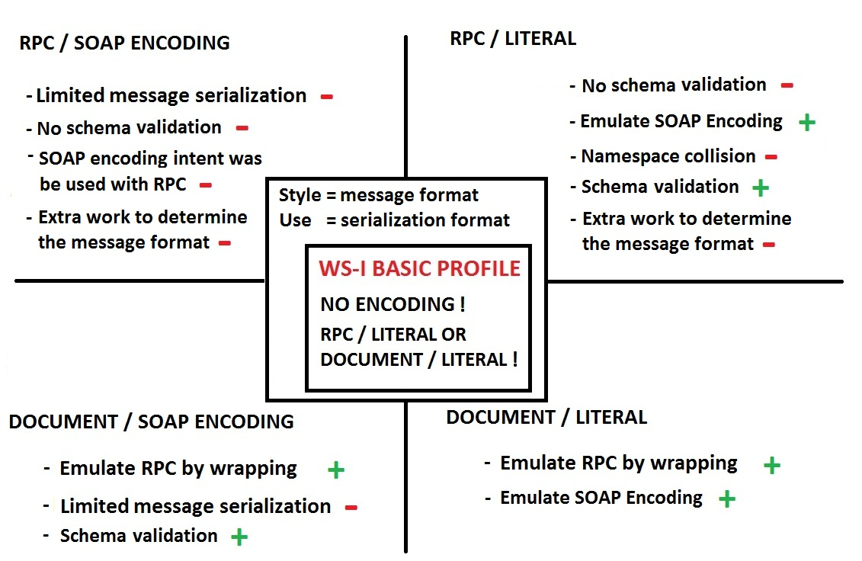

Slide 16
An overview

Slide 17
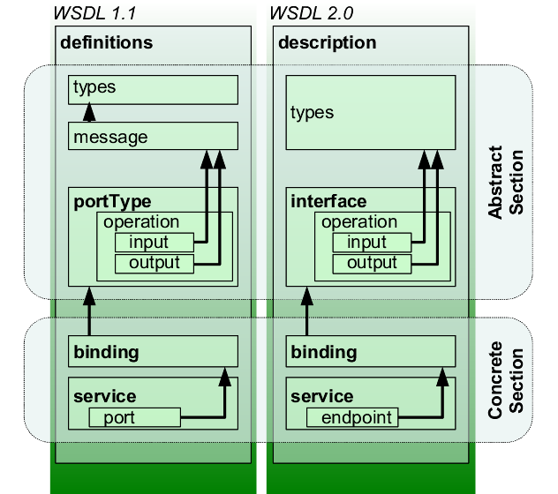
From 1.1 to 2.0
message is integrated in interface
Interfaindicativece is more clear than portType
A binding is now reusable.
Adequate HTTP binding
Notes:
A binding is now reusable. It doesn't need to be associated with a specific interface. The association can be made in the service declaration.

Slide 18
An overview

Slide 19
WADL
Binding occurs only with the HTTP protocol
Major in Resource oriented web services
Components:
application – root element
resources – resources provided by the application
method– defines the HTTP to be called + parameters
response– an HTTP status code
Notes:
WADL is equivalent WSDL where binding occurs only with the the HTTP protocol (WSDL may accept several protocols – SOAP, HTTP, etc. ). The description language favours an implementation of a resource oriented architecture, but does not condition it, any HTTP based service may be defined through this language.

Slide 20
An overview

Slide 21
Why not to RESTful…
Why& Why Not?
Does WSDL always have to describe SOAP-based web services? Can it describe RESTful web services?
Why not:
SOAP ,SMTP, or plain HTTP.
In WSDL 2.0, it can even describe RESTful web services

Slide 22
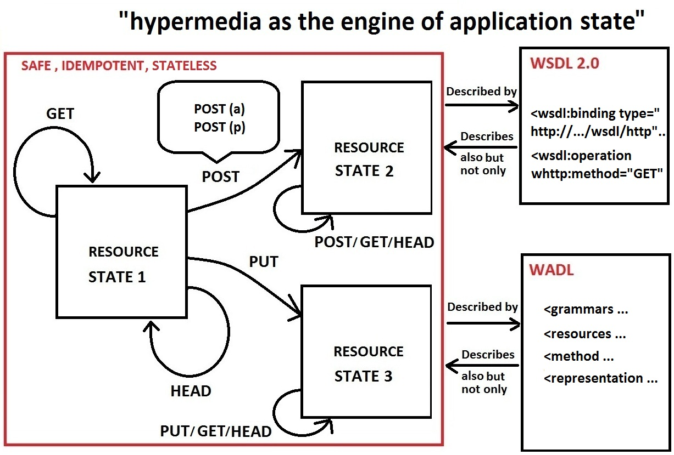

Slide 23
Why?
UDDI
Universal Description, Discovery, and Integration
WSDL
SOAP
SOAP+WSDL+UDDI
vs
RESTful Web Services
Notes:
SOAP defines how the messages is transported, while WSDL is used for define web services.

Slide 24
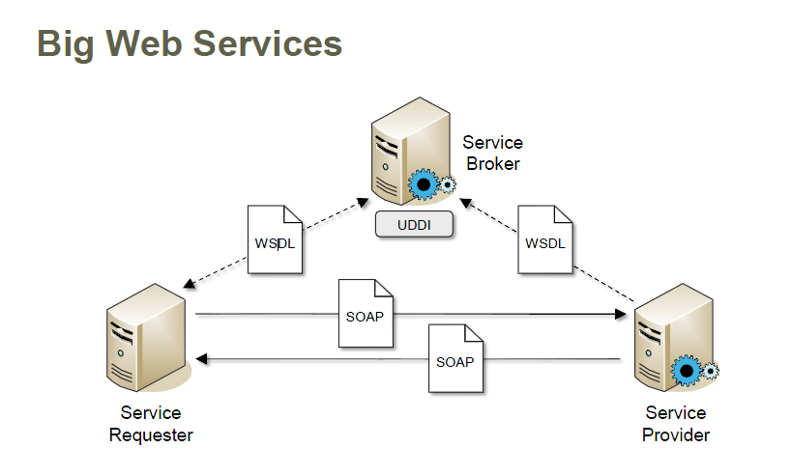
WS-
Src: Web Information Systems Lecture Slides: Web 2.0 Patterns,Beat Signer

Slide 25
Why?
SOAP+WSDL+UDDI
RESTful
XML,XML,XML
no mechanism for the caching of results
complexity
stateless
cacheability
layering
simple
CRUD
better integrated with HTTP and web browsers
Notes:
Simple: json
▪ yellow pages for WSDL
▪ "global" registry describing available business services
▪ very complex
▪ Microsoft and IBM shut down their public UDDI registries in 2006

