Slide 1
SOAP
Quang Vinh Pham
Simon De Baets

Slide 2
Plan
Introduction
Structure and Semantics
Error Handling
Processing Model
Transport Protocol
SOAP and Web Services

Slide 3
What’s SOAP ?
NOT THIS !

Slide 4
Introduction : Definition
Simple Object Access Protocol (SOAP)
Lightweight wire protocol for exchanging structured information over computer networks.

Slide 5
Introduction : Service
Allows multiplaform exchange, interoperability.
Loosely coupled
Very scalable (use of HTTP)
Allows asymmetrical communication
Client-server
Applications can be implemented under different models

Slide 6
Introduction : Evolution
1998 :
Creation by Winer, Box, Akthinson and Al-Ghosein for Microsoft.
Orignally Object Access Protocol.
2003 : v1.2.
W3C recommandation.

Slide 7
Structure

Slide 8
Semantics : Envelope
Specify :
Namespace
Encodingstyle : Set of rules that describes how data can be serialized to xml.

Slide 9
Semantics : Envelope

Slide 10
Semantics : Header
Immediate child of envelope.
The Header element information item has:
A local name of Header .
A namespace name of "http://www.w3.org/2003/05/soap-envelope".
Zero or more namespace qualified attribute information items in its attributes property.
Zero or more namespace qualified element information items in its children property.

Slide 11
Semantics : Header Blocks
Child of header.
Each SOAP header block element information item:
MUST have a namespace name property which has a value.
MAY have any number of character information item children.
MAY have any number of element information item children.

Slide 12
Semantics : Header Blocks
Each SOAP header block element information item:
MAY have zero or more attribute information items in its attributes property :
encodingStyle
role
mustUnderstand
relay

Slide 13
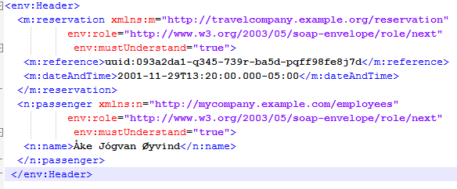
Semantics :Header

Slide 14
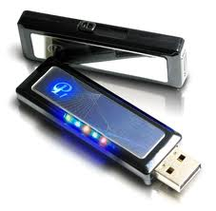
Semantics : Body
Area where the data are stored.
Format change with the chosen communication model.

Slide 15
Semantics : Body
The Body element information item has:
A local name of Body .
A namespace name of "http://www.w3.org/2003/05/soap-envelope".
Zero or more namespace qualified attribute information items in its attributes property.
Zero or more namespace qualified element information items in its children property.

Slide 16
Semantics : Body
All child element information items of the SOAP Body element information item:
SHOULD have a namespace name property which has a value.
MAY have any number of character information item children.
MAY have any number of element information item children.
MAY have zero or more attribute information items in its attributes property.

Slide 17
Semantics : Body

Slide 18
An Example : Travel Reservation

Slide 19
An Example : Travel Reservation

Slide 20
Error Handling
SOAP provides some model to manage errors.
This information is located in the body

Slide 21
Error Handling
All the iformations is contained in the <env: fault> element.
<env:fault>
<env:code>
<env:reason>
<env:Detail> (optional)
<env:Node> (optional)
<env:Role> (optional)

Slide 22
Error Handling

Slide 23
Processing Model
Goal : send a SOAP information since the SOAP sender to the SOAP reciever.

Slide 24
Procesing Model
SOAP Message Path for validating purchase order.
1) Submit digitally signed purchase order
Purchasing service node
Customer Node
2) Validate digital signature
Signature validation node
3) Process purchase order

Slide 25
Processing Model
SOAP attributes for processing Model
Role (none, next, ultimateReceiver)
mustUnderstand
relay

Slide 26
Processing Model

Slide 27
Transport protocol
SOAP purpose
exchanging data over networks
binding mechanism between two endpoints
SOAP message = XML document
Carried by network protocol
HTTP, SMTP, FTP, MSMQ, …
Network protocol does not affect the design of SOAP message

Slide 28
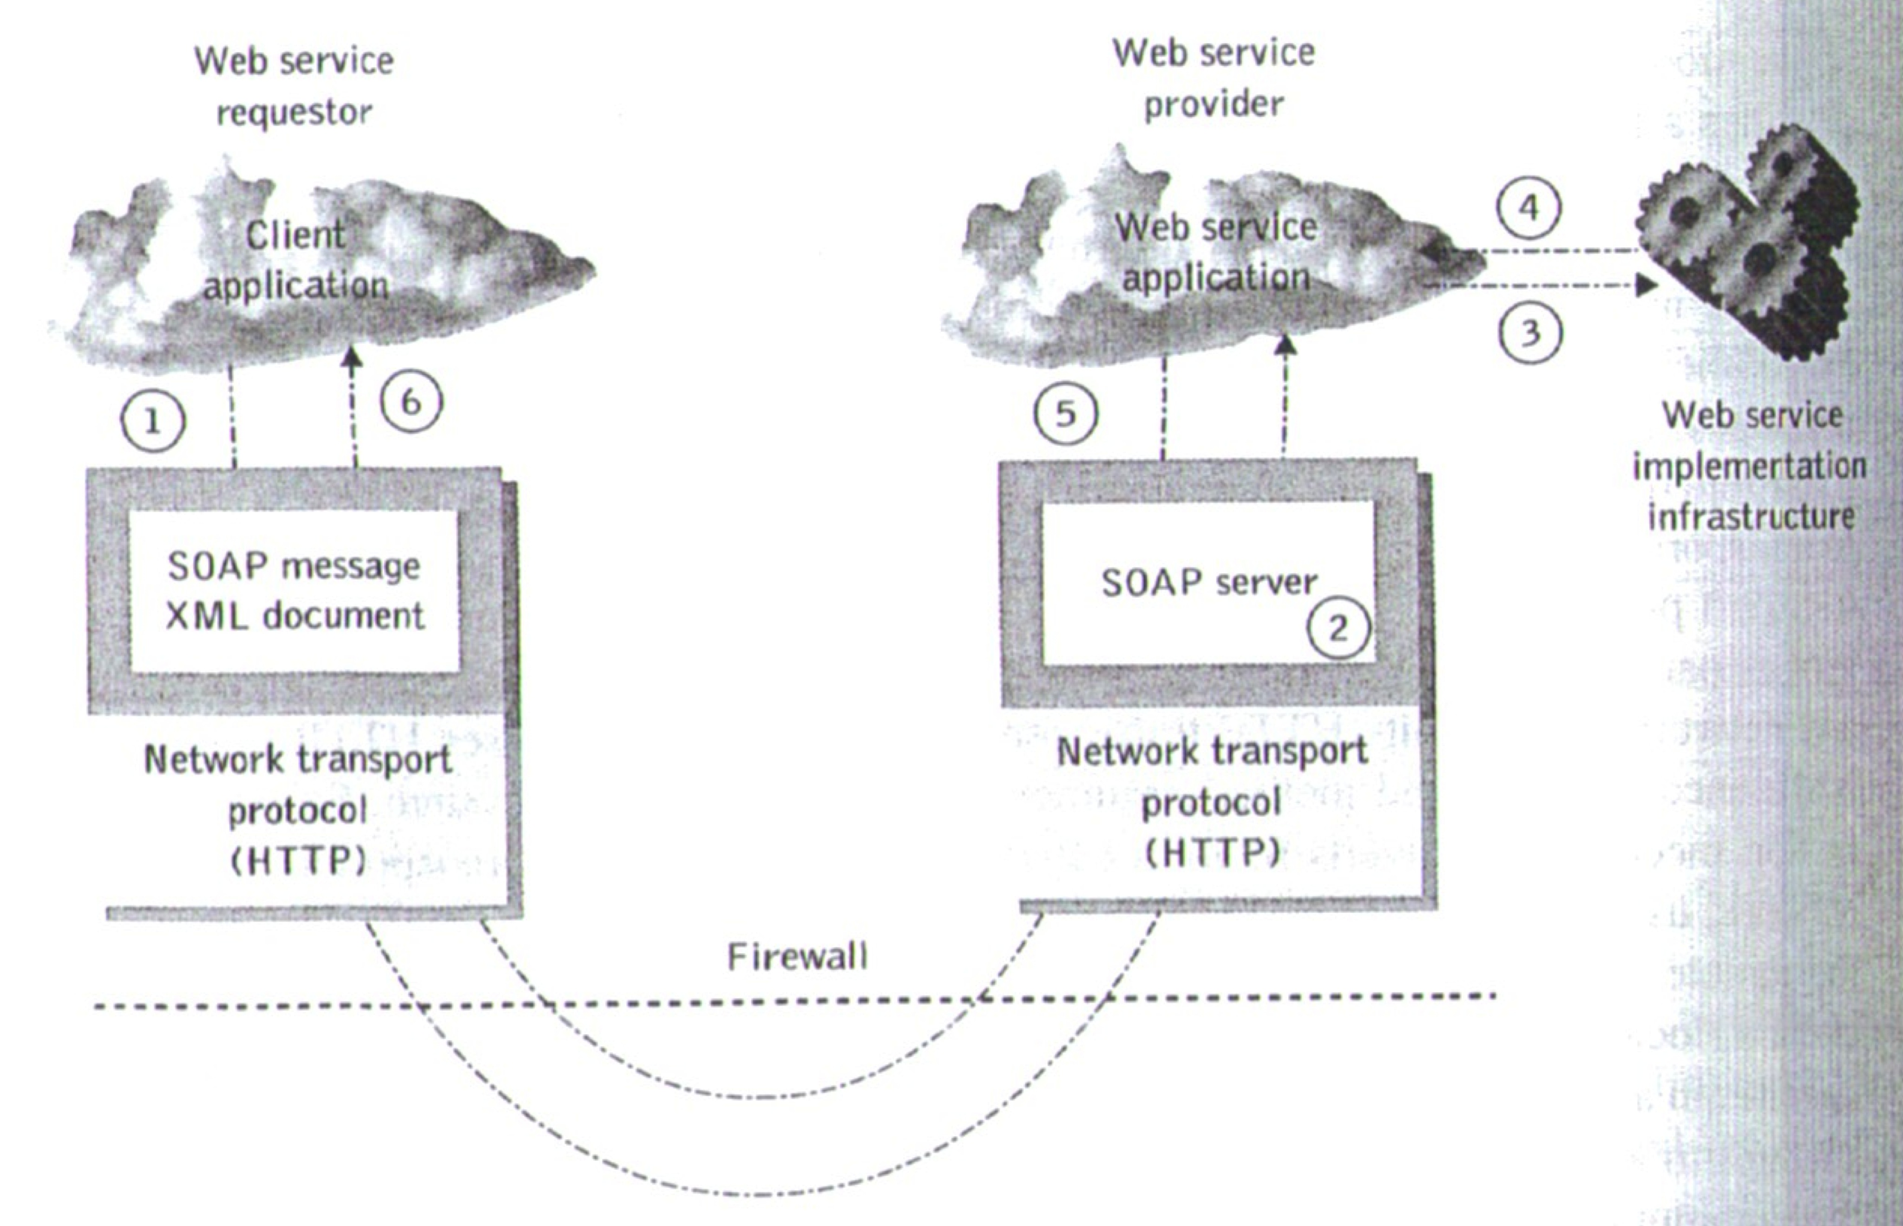
Transport protocol
Purpose : communication between two endpoints
SOAP node requirement
Construct and parse SOAP messages
Communication over the network

Slide 29
Transport protocol : HTTP
Most commonly used
Natural transport protocol for SOAP
HTTP GET : retrieval of resource
Request : plain HTTP GET
Response : SOAP message in body
HTTP POST : modification of resource
Request / response : SOAP message in body
One-way message or request/response over HTTP

Slide 30
SOAP request

Slide 31
SOAP response

Slide 32
HTTP SOAP GET request

Slide 33
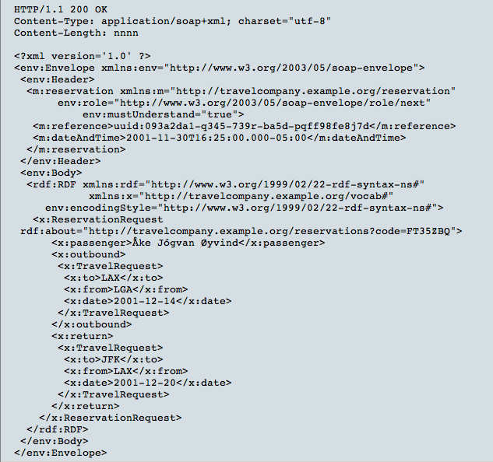
HTTP SOAP GET response

Slide 34
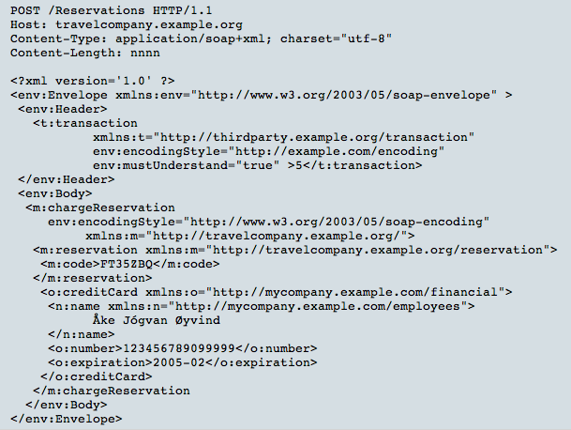
HTTP SOAP GET request

Slide 35
Transport protocol : SMTP
Advantage : store and forward
Suitable for partially connected nodes, one way notifications, …
SOAP payload contained in a MIME message

Slide 36
Communication model
Two ways to address a Web service
RPC
Document
Affect the design of the SOAP message

Slide 37
SOAP and RPC
RPC : remote procedure call
Web service : remote object
Client’s request : method call with arguments
Server’s response : return result

Slide 38
SOAP and RPC
SOAP message (RPC request)
URI for remote object to be called
Method name as a structure
Input parameters as fields in the structure
Name and order are crucial
Response
Return value
Output parameters
XML representation of a system structure

Slide 39
SOAP and RPC

Slide 40
SOAP and RPC
Automatic serialization/deserialization
Tightly coupled
Synchronous
Can expose traditional components as Web services
Servlet
Stateless session bean
Java RMI object
…

Slide 41
SOAP and message-style WS
Any kind of XML data
No restriction on the contents
Message driven
Client sends entire document
Web service processes document
WS may or may not return a response
Asynchronous communication
No automatic serialization/deserialization

Slide 42
SOAP and message-style WS
SOAP message
Body : XML document fragment
Body : reflect no explicit XML structure

Slide 43
Document-style

Slide 44
SOAP vs REST
Remind REST :
4 keys concepts :
Ressources
Ressource names (URI’s)
Ressource representation
Links between ressource

Slide 45
SOAP vs REST
And 4 key properties :
Addressability
Statelessness
Connectedness
The Uniform Interface

Slide 46
SOAP vs REST
Does SOAP support the REST-based style ?
Ressources
URI’s
Ressource representation
Links between ressource
Addressability
Statelessness
Connectedness
The Uniform Interface

Slide 47
References
M. P. Papazoglou, Web Services: Principles and Technology, chapter 4, pages 119-145.
http://www.w3.org/TR/soap12-part0/.
http://msdn.microsoft.com/en-us/library/ms995800.aspx

Slide 48
QUESTIONS

