Slide 1
Web services security I
Uyen Dang & Michel Foé

Slide 2
Agenda
Context
Architectural considerations of security issues in WS
Security threats in Web services
Basic concepts (prerequisites)
XML independent tools or technologies
SSL
Kerberos
Authentication on HTTP
XML specific tools or technologies
XML signature
XML Encryption
XKMS
SAML
XACML
Summary and Q&A

Slide 3
Context (SOA)
Notes:
SOA facilitate service integration within and accross organization boundaries
services are combined with each other in unanticipated ways → anonymous
No more islands of security
The drawback of SOA is that security systems should be integrated too
Need of tracability in transaction
Authencity
Access control, identity, authentication
Business impact

Slide 4
Architectural considerations of WS security
Where security issues occur in SOA?
Network-level
Application-level

Slide 5
Security threats for Web services
Unauthorized access
Unauthorized alteration of messages
Man in the middle
Denial of service

Slide 6
Countermeasures (1)
Network-level security:
Firewalls
Intrusion detections systems and vulnerability assessment
Securing network communications
symmetric /asymmetric encryption
Digital certificates and signatures

Slide 7
Countermeasures (2)
Application-level security:
Six requirements
Authentication
Authorization
Message integrity
Confidentiality
Operational defense
Non repudiation

Slide 8
Basic concepts (1)
Authentication
Verify the identity of an entity
Authorization
Specify access rights to a resource

Slide 9
Basic concepts (2)
Integrity
Guarantee that a message did not change in transit/time
Confidentiality
Ensure that data is available only to those who are authorized to access

Slide 10
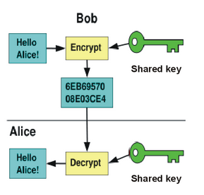
Basic concepts (3)
Symmetric encryption /decryption
Secure communication between two parties
Both parties share the same key

Slide 11
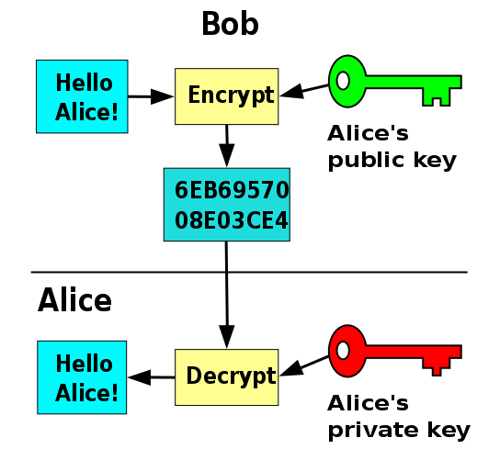
Basic concepts (4)
Asymmetric encryption /decryption
Secure communication between two parties
Requires public/private keys pair for each party

Slide 12
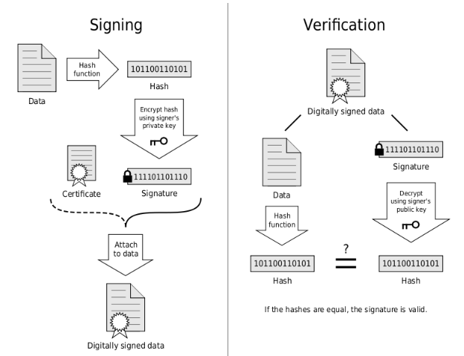
Basic Concepts(5)
Digital signature and certificate
Proof the authenticity and integrity of a document/message
Ensure accountability and non-repudiation (certificates)

Slide 13
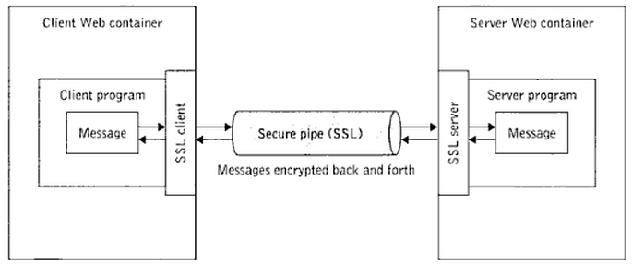
SSL (Secure Sockets Layer )
What is SSL?
Web protocol
secure communication over TCP/IP connections,
provides server and client authentication,
data encryption, message integrity.

Slide 14
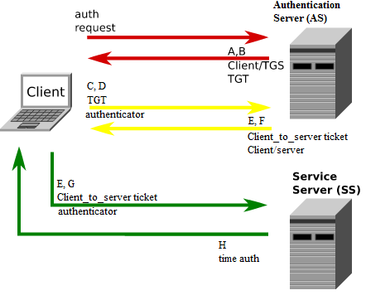
Kerberos
What is Kerberos?
3rd party Authentication protocol
Use ticket and a session key
Centralized key management
Allows single-sign-on
Notes:
Ticket: pieces of information (session key + expire date) used for authentication or authorization added to a SOAP header
Session key: secret key randomly generated by kerberos

Slide 15
Authentication on HTTP
Login/password authentication
Support two methods:
Basic authentication
Base64 algorithm to encrypt the string login:password
Highly vulnerable
Digest
Apply a hash function to the password

Slide 16
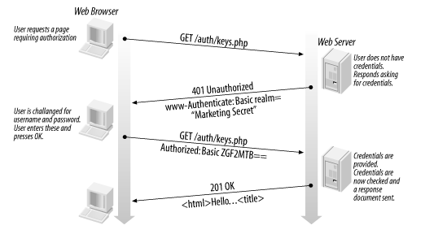
http basic authentication example

Slide 17
XML signature
Ensure :
data integrity,
message authentication,
and non-repudiation.
3 types of signatures:
Enveloping
Enveloped
Detached signatures or
Notes:
Provides proof of identity and authenticity which the sender cannot deny

Slide 18
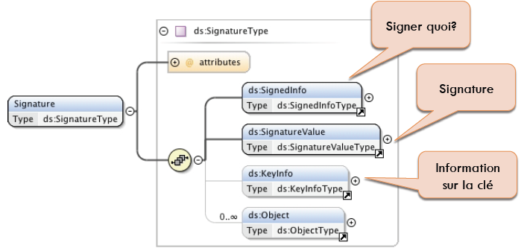
XML signature (schema)
SignedInfo
Signature
Key information

Slide 19
XML signature (SignedInfo)

Slide 20
XML Signature (key information)

Slide 21
XML Signature (How does it work?)
Generate references
Transformation (eventually)
Compute the digest
Generate the signature
Build SignedInfo element
Apply CanonicalizationMethod
Compute the digest
Compute the signature on hash with SignatureMethod
Just SignedInfo is signed not referenced resources

Slide 22
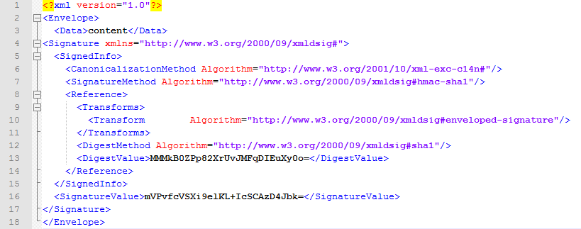
XML Signature (Example)
enveloping
enveloped

Slide 23
XML Encryption
Encrypts part/whole XML document
Ensure confidentiality
Use symmetric encryption

Slide 24
XML Encryption (schema)
Encryption method
Cipher text

Slide 25
XML Encryption (How does it work?)
Encryption
Choose the cryptographic algorithm (3DES , AES, etc..)
Get or generate the key
Serialize data to encrypt
Encrypt
Decryption
Identify algorithm and key used
Get the key
Decrypt
Integrate data in the final document

Slide 26
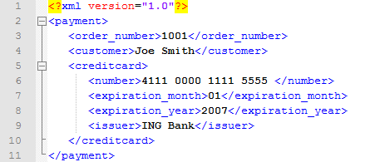
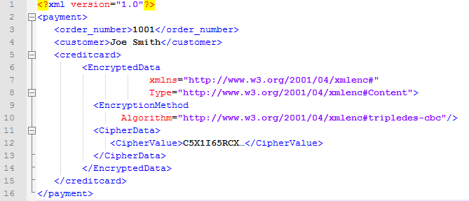
XML Encryption (Example)

Slide 27
Are XML encryption and signature tied to WS - *?
XML Encryption can be applied to any Web resource (including non-XML content).

Slide 28
XKMS (XML Key Management Spec)
Alternative to a complex PKI
Ease integration of
Authentication,
signature and certificates,
and encryption for XML- based trust services;
Support three major services:
Register
Locate
validate
Notes:
Register service: for registering key pairs
Locate service: retrieving public registered key
Validate service: locate and verify that a public key registered with the XKMS server is not revoked and is still valid in time

Slide 29
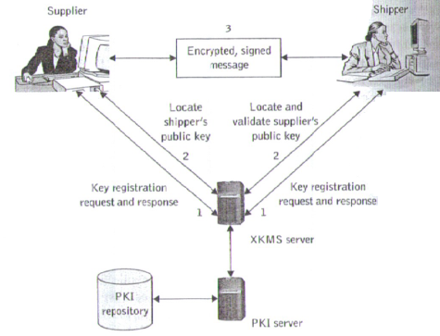
XKMS (example)
4

Slide 30
SAML
Security assertion Markup Language
OASIS standard
framework for
creating,
requesting,
and exchanging security assertions between business partners
→ Ease Single Sign-On
Notes:
Why SAML?

Slide 31
SAML components

Slide 32
SAML assertion
Notes:
SAML Assertions provide a means to distribute security-related information that may be used for a
number of purposes

Slide 33
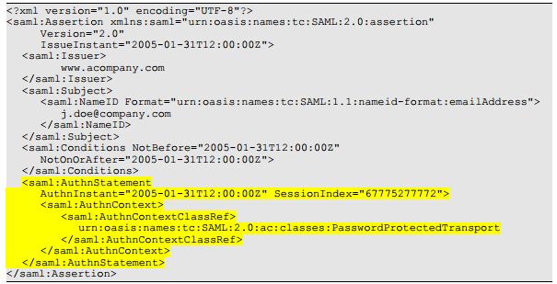
SAML example
Notes:
The subject (e.g. user) that the authentication pertains to is “j.doe”. The format of the subject has been
defined. In this case its an email address, a number of predefined formats have been provided in the
SAML specification, including custom formats and X.509 subject names.
Joe was originally authenticated using a protected password mechanism at “2005-01-31T12:00:00Z"

Slide 34
XACML
eXtensible Access Control Markup Language
extension to SAML
define how to use access information and security policies
offer a vocabulary and syntax for managing authorization decisions
Two basics components
Access control policy language
Request /response language
Notes:
SAML just define how identity and access information is exchanged between partners

Slide 35
Typical use of XACML and SAML

Slide 36
Summary and Q&A
Technology | Main purposes
XML signature | data integrity, authentication, non -repudation of services
XML encryption | promote the trusted use of web applications by encrypting XML entities
XKMS | simplify the integration of PKI and management of digital certificates with XML applications
SAML | Standards or exchanging authorization and authentication assertions between services to facilitate Single Sign On
XACML | Language for managing authorization decisions

