Slide 1
DATA ANALYTICS on web scale
Lecture 10

Slide 2
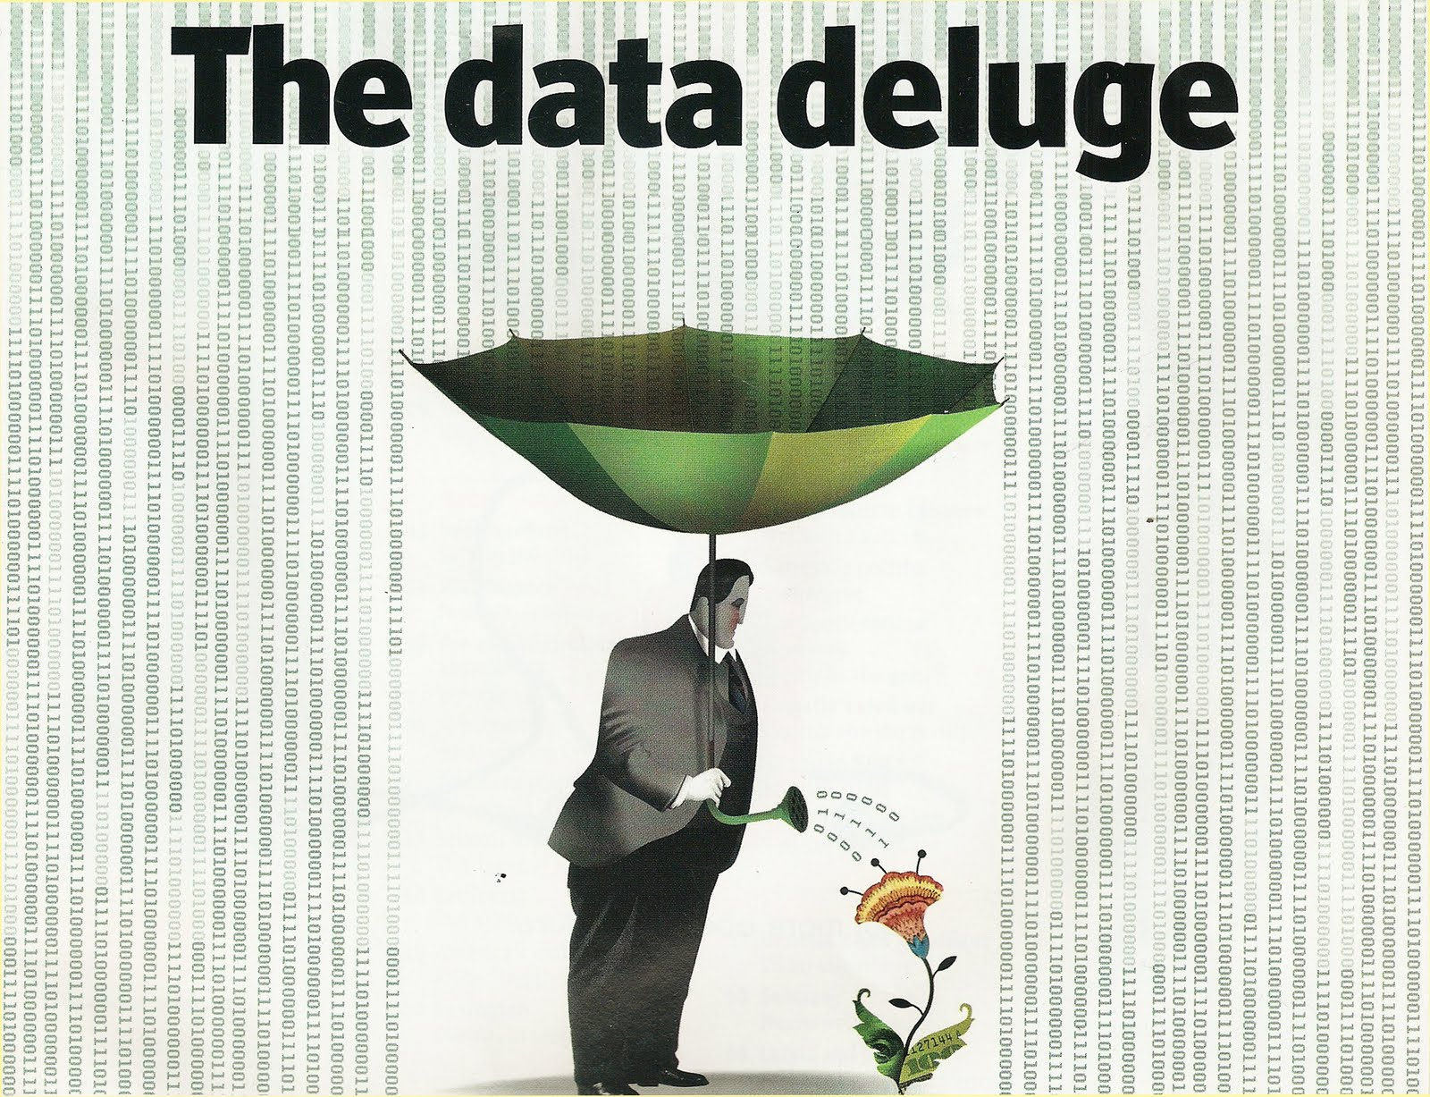
Source: The Economist, February 25, 2010

Slide 3
The Data Deluge
“
EIGHTEEN months ago, Li & Fung, a firm that manages supply chains for retailers, saw 100 gigabytes of information flow through its network each day. Now the amount has increased tenfold. During 2009, American drone aircraft flying over Iraq and Afghanistan sent back around 24 years' worth of video footage. New models being deployed this year will produce ten times as many data streams as their predecessors, and those in 2011 will produce 30 times as many.
Source: The Economist, February 25, 2010

Slide 4
The Data Deluge
“
Everywhere you look, the quantity of information in the world is soaring. According to one estimate, mankind created 150 exabytes (billion gigabytes) of data in 2005. This year, it will create 1,200 exabytes. Merely keeping up with this flood, and storing the bits that might be useful, is difficult enough. Analysing it, to spot patterns and extract useful information, is harder still.
1 gigabyte = 10⁹ bytes
1 terabyte = 10¹² bytes
1 petabyte = 10¹⁵ bytes
1 exabyte = 10¹⁸ bytes
Source: The Economist, February 25, 2010

Slide 5
The Data Deluge on the Web
Social Networks
(Facebook, Twitter)
Web Pages & Links
Web Data Deluge
Internet e-commerce
Web Surfer History & Contextualization
(Smartphones)
Notes:
All generating huge amounts of valuable data

Slide 6
Why analyze this data?
Sentiment analysis
E-marketing
Click Stream Analysis
Social Networks
(Facebook, Twitter)
Web Pages & Links
Web Data Deluge
Internet e-commerce
Web Surfer History & Contextualization
(Smartphones)
Web Search Index Construction
Recommender systems & advertising
Notes:
Google revenue from ads: 42.5 billion $USD in 2012!

Slide 7
Is this really problematic?
“
Although it is hard to accurately determine the size of the Web at any point in time, it is safe to say that it consists of hundreds of billions of individual documents and that it continues to grow. If we assume the Web to contain 100 billion documents, with an average document size of 4 kB (after compression), the Web is about 400 TB …
… The size of the resulting inverted (web search) index depends on the specific implementation, but it tends to be on the same order of magnitude as the original repository.
Source: The Datacenter as a Computer Luiz André Barroso (Google)
Jimmy Clidaras (Google)
Urs Hölzle (Google)
Notes:
So: just computing the index to serve google from is far from trivial.

Slide 8
Limitations of Traditional Data Analytics Architecture
Data Collection Processes
Data Storage Infrastructure
[Storage only, no computation]
Moving the data to another infrastructure to perform computation does not scale
Extract-Transform-Load (ETL)
Compute Grid
Relational Database System
(Containing Aggregated Data only)
Interactive applications + Reporting
(On aggregated data only)
Impossible to explore RAW data
Notes:
Data Storage size was usually limited. (Tape archiving for old data = premature data death)
For Traditional analysis tools you need to load the data from the format that you have it in to a structured format that the DBMS can deal with = bottleneck
Data is arriving faster than that the time it takes to analyze it → data = useless

Slide 9
Google’s solutions
New programming models and frameworks for distributed and scalable data analysis
Name | Purpose
Google File System | A distributed file system for scalable storage and high-throughput retrieval
Map Reduce | A programming model + execution environment for general-purpose distributed batch processing
Pregel | A programming model + execution environment for analysis of graphs
Dremel | A query language for interactive SQL-like analysis of structured datasets
Open Source Impl
Apache Hadoop HDFS M/R
Apache Giraph
Apache Drill
High-level design described in a series of papers; no implementation available
Notes:
These are described in high-level papers; the concepts of these papers have been implemented in open-source products

Slide 10
Rest of this lecture
Execution hardware
HDFS: Hadoop Distributed File System
Map/Reduce
Pregel

Slide 11
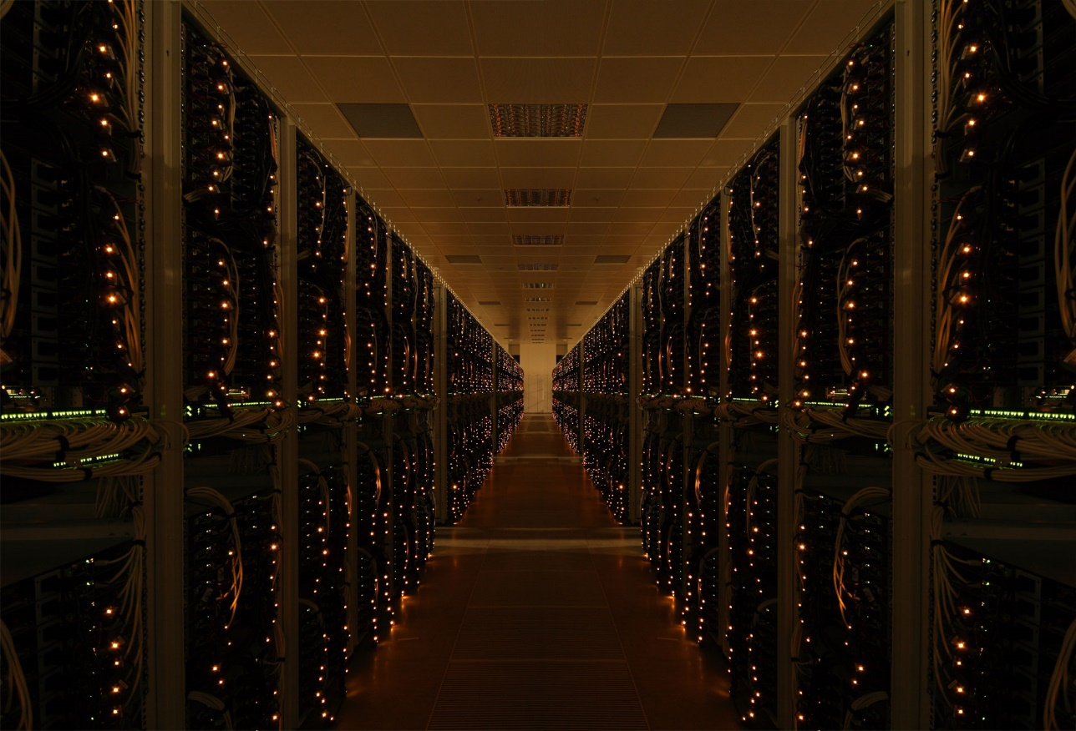
Warehouse scale Machines

Slide 12
Execution environment - 1997
Just a bunch of computers.
The web index fit on a single computer
Redundancy to ensure availability

Slide 13
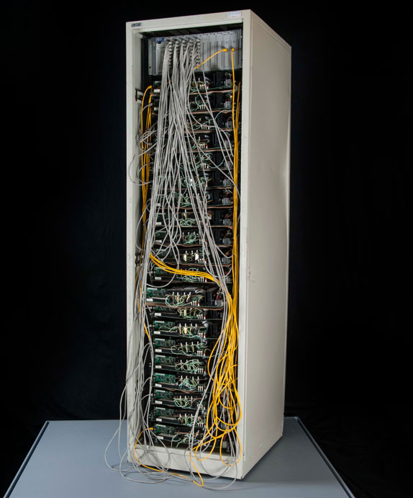
Execution environment - 1999
Compute servers consist of multiple CPUs (possibly with multiple cores per CPU), and attached hard disks,
Servers are collected in racks. High-speed Ethernet connections (at least 1Gbps) connect servers in a rack together
The Google “Corckboard” rack

Slide 14
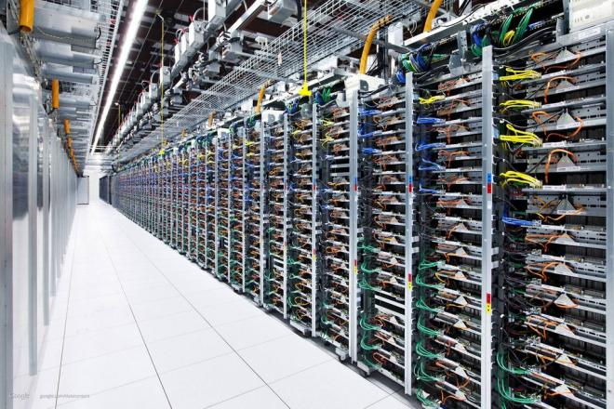
Execution environment - currently
An image of the google datacenter in Mons (Belgium)
Racks are connected together to central network switches using multi-Gbps redundant links.
Access of data from other racks is slower than data on same computer/same rack
Many racks together form a data center

Slide 15
Discussion
Each compute node is kept simple by design:
Mid-range computers are much cheaper than powerful high-range computers …
… and consume less energy
… but google has lots of them!

Slide 16
Characteristics
Conclusion:
Huge storage capacity
Latency between racks = 1/10 latency on rack level ≈ 1/10 latency on server level
Bandwidth between racks = 1/10 bandwidth on rack level = ½ to 1/10 bandwidth on server level
Bandwidth: the speed at which data can be transferred to the same machine/another server on the same rack/another server ona different rack
Capacity: The amount of data we can store per server/rack/datacenter
Latency: The time it takes to fetch a data item, when asked on local machine/another server on the same rack/another server on a different rack
Figure Source: The Datacenter as a Computer

Slide 17
What do we gain? Parallellism!
Let us consider the maximal aggregate bandwidth: the speed by which we can analyze data in parallel assuming ideal data distribution over servers & disks
“Embarassingly parallel” example: count the number of times the word “Belgium” appears in documents on the Web.
Each server has multiple CPUs and can read from multiple disks in parallel. As such, each server can analyze many documents in parallel.
At the end, sum the per-server counters (which can be done very fast)

Slide 18
What do we gain? Parallellism!
Let us consider the maximal aggregate bandwidth: the speed by which we can analyze data in parallel assuming ideal data distribution over servers & disks
Component |  | Max Aggr Bandwidth
1 Hard Disk |  | 100 MB/sec (≈ 1 Gbps)
Server | = 12 Hard Disks | 1.2 GB/sec (≈ 12 Gbps)
Rack | = 80 servers | 96 GB/sec (≈ 768 Gbps)
Cluster/datacenter | = 30 racks | 2.88 TB/sec (≈ 23 Tbps)
Scanning 400TB hence takes 138 secs ≈ 2,3 minutes
Scanning 400TB sequentially at 100 MB/sec takes ≈ 46,29 days

Slide 19
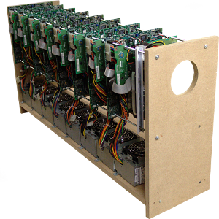
The challenge
Scalable software development: allow growth without requiring re-architecting algorithm/applications
Auto scale

Slide 20
Google’s solutions
New programming models and frameworks for distributed and scalable data analysis
Name | Purpose
Google File System | A distributed file system for scalable storage and high-throughput retrieval
Map Reduce | A programming model + execution environment for general-purpose distributed batch processing
Pregel | A programming model + execution environment for analysis of graphs
Dremel | A query language for interactive SQL-like analysis of structured datasets
Open Source Impl
Apache Hadoop HDFS M/R
Apache Giraph
Apache Drill
High-level design described in a series of papers; no implementation available
Notes:
These are described in high-level papers; the concepts of these papers have been implemented in open-source products

Slide 21
HDFS: The Hadoop distributed file sytem

Slide 22
HDFS Architecture
HDFS has a master/slave architecture
Master = NameNode (NN) manages the file system and regulates access to files by clients.
Slaves = DataNodes (DN), usually one per server in the cluster, manage storage attached to the server that they run on.
Files are transparently broken down into blocks (default 64 MB).
Blocks are replicated across datanodes. Replication is rack-aware.
NameNode
MetaData(FileName, Replication Factor, Block Ids)
/users/sv/dat0.txt r:2 {1,3}
/users/sv/dat1.txt r:3 {2, 4, 5}
DataNodes
dat0.txt
1
3
dat1.txt
2
4
5
1
2
2
5
1
3
2
4
4
5
3
4
5
Notes:
Remark: NameNode never sees the actual data blocks, these are sent directly to datanodes!

Slide 23
HDFS Architecture
HDFS has a master/slave architecture
Master = NameNode (NN) manages the file system and regulates access to files by clients.
Slaves = DataNodes (DN), usually one per server in the cluster, manage storage attached to the server that they run on.
Optimized for:
Large files
Read throughput
Appending writes
Replication ensures:
Durability
Availability
Throughput
NameNode
MetaData(FileName, Replication Factor, Block Ids)
/users/sv/dat0.txt r:2 {1,3}
/users/sv/dat1.txt r:3 {2, 4, 5}
DataNodes
1
2
2
5
1
3
2
4
4
5
3
4
5
Notes:
Remark: NameNode never sees the actual data blocks, these are sent directly to datanodes!

Slide 24
Writing files
Todo if time: illustration of how files are written

Slide 25
HDFS Implementation
“
This implies that clients only need to install a JAR file to access the HDFS
The NameNode and DataNode are pieces of software designed to run on commodity machines. These machines typically run a GNU/Linux operating system (OS). HDFS is built using the Java language; any machine that supports Java can run the NameNode or the DataNode software. Usage of the highly portable Java language means that HDFS can be deployed on a wide range of machines.
Source: Hadoop documentation

Slide 26
Typical HDFS commands
bin/hadoop fs –ls
bin/hadoop fs –mkdir
bin/hadoop fs –copyFromLocal
bin/hadoop fs –copyToLocal
bin/hadoop fs –moveToLocal
bin/hadoop fs –rm

Slide 27
Map/REDUCE: Simplified data processing on large clusters

Slide 28
M/R Computational Model
A M/R program (or job) is specified by two functions: map and reduce
The input key/value pair represents a logical record in the input data source. In the case of a file this could be a line, or if the input source is a database table, this could be a record,
map: (key1, value1) -> list(key2, value2)
A single input key/value pair may result in zero or more output key/value pairs.

Slide 29
M/R Computational Model
A M/R program (or job) is specified by two functions: map and reduce
The reduce function is called once per unique map output key, and receives a list of all values emitted for that key
reduce: (key2, list(value2)) -> list(key3, value3)
Like the map function, reduce can output zero to many key/value pairs.

Slide 30
M/R Computational Model
For each word occurring in a document on the Web, count the number of occurrences across all documents.
def map(docid, line):
for each word in line:
yield (word, docid)
def reduce(word, list-of-docids):
yield (word, sizeof(list-of-docids))

Slide 31
M/R: opportunity for parallellism
We can spawn multiple copies of the map function (called map tasks) in parallel (at most one for each key/value pair).
Likewise, we can spawn multiple copies of the reduce function (called reduce tasks) in parallel (at most one for each unique key output by the map).
Input
map output
shuffle+sort
reduce input
doc1
map
cat, d1
dog, d1
turtle, d1
cat, [d1,d2]
reduce
map
dog, [d1,d3]
reduce
doc2
cat, d2
belgium, d2
turtle, [d1,d3]
reduce
doc3
map
turtle, d3
dog, d3
reduce
belgium, [d2]

Slide 32
M/R Execution: Architecture
Master = JobTracker – accepts jobs, decomposes them into map and reduce tasks, and schedules them for remote execution on child nodes.
Slave = TaskTracker – accepts tasks from Jobtracker and spawns child processes to do the actual work.
Idea: ship computation to data
The JobTracker accepts M/R jobs.
If the input is a HDFS file, a map task is created for each block and sent to the node holding that block for execution.
Map output is written to local disk.
NameNode
JobTracker
Job1
Map task 1
Map task 2
Reduce task 1
Reduce task 2
Job2
…
DataNodes = TaskTrackers
1
2
2
5
1
3
2
4
4
5
3
4
5

Slide 33
M/R Execution: Architecture
Master = JobTracker – accepts jobs, decomposes them into map and reduce tasks, and schedules them for remote execution on child nodes.
Slave = TaskTracker – accepts tasks from Jobtracker and spawns child processes to do the actual work.
Idea: ship computation to data
The JobTracker creates reduce tasks intelligently
Reduce tasks read the map outputs over the network and write their output back to HDFS.
NameNode
JobTracker
Job1
Map task 1
Map task 2
Reduce task 1
Reduce task 2
Job2
…
DataNodes = TaskTrackers
1
2
2
5
1
3
2
4
4
5
3
4
5

Slide 34
M/R Execution: Architecture
Master = JobTracker – accepts jobs, decomposes them into map and reduce tasks, and schedules them for remote execution on child nodes.
Slave = TaskTracker – accepts tasks from Jobtracker and spawns child processes to do the actual work.
Idea: ship computation to data
Load balancing: The JobTracker monitors for stragglers and may spawn additional map on datanodes that hold a block replica. Whichever node completes first is allowed to proceed. The other(s) is/are killed.
NameNode
JobTracker
Job1
Map task 1
Map task 2
Reduce task 1
Reduce task 2
Job2
…
DataNodes = TaskTrackers
1
2
2
5
1
3
2
4
4
5
3
4
5

Slide 35
M/R Execution: Architecture
Master = JobTracker – accepts jobs, decomposes them into map and reduce tasks, and schedules them for remote execution on child nodes.
Slave = TaskTracker – accepts tasks from Jobtracker and spawns child processes to do the actual work.
Idea: ship computation to data
Failures: In clusters with 1000s of nodes, hardware failures occur frequently. The same mechanism as for load balancing allows to cope with such failures
NameNode
JobTracker
Job1
Map task 1
Map task 2
Reduce task 1
Reduce task 2
Job2
…
DataNodes = TaskTrackers
1
2
2
5
1
3
2
4
4
5
3
4
5

Slide 36
Pregel: a system for large-scale data processing

Slide 37
References
S. Ghemawate, H. Gobioff H.-T. Leung The Google File System http://research.google.com/archive/gfs-sosp2003.pdf
HDFS architecture: http://hadoop.apache.org/docs/stable/hadoop-project-dist/hadoop-hdfs/HdfsDesign.html
Jeffrey Dean and Sanjay Ghemawat MapReduce: Simplified Data Processing on Large Clusters Communications of the ACM 2008
G. Malewicz, M. H. Austern, A. J. C. Bik, J. C. Dehnert, I. Horn, N. Leiser, and G. Czajkowski . Pregel: a system for large scale graph processing http://kowshik.github.io/JPregel/pregel_paper.pdf
L. A. Barroso, J. Clidaras, U. Hölzle The datacenter as a computer. http://www.morganclaypool.com/doi/abs/10.2200/S00516ED2V01Y201306CAC024

